Slide 1
Overview
Constructing GUIs
Interface components
GUI layout
Event handling

Slide 2
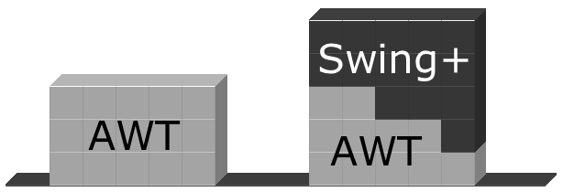
AWT and Swing

Slide 3
Graphical input and output with JOptionPane

Slide 4
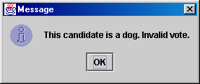
JOptionPane
An option pane is a simple dialog box for graphical input/output
advantages:
  simple
  flexible (in some ways)
  looks better than the black box of death
disadvantages:
  created with static methods;
  not very object-oriented
  not very powerful (just simple dialog boxes)

Slide 5
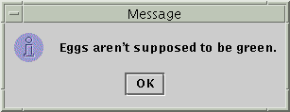

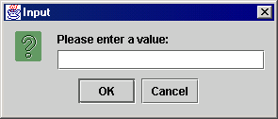
Types of JOptionPanes
showMessageDialog(<parent>, <message>)
Displays a message on a dialog
with an OK button.
showConfirmDialog(<parent>, <message>)
Displays a message and list of
choices Yes, No, Cancel;
returns user's choice as an int with one
of the following values:
  JOptionPane.YES_OPTION
  JOptionPane.NO_OPTION
  JOptionPane.CANCEL_OPTION
showInputDialog(<parent>, <message>)
Displays a message and text
field for input; returns the user's
value entered as a String.
  can pass null for the parent to all methods

Slide 6
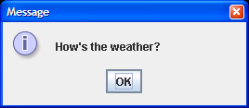
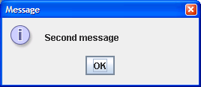
JOptionPane examples 1
showMessageDialog analogous to System.out.println to display a message
import javax.swing.*;
public class MessageDialogExample {
public static void main(String[] args) {
JOptionPane.showMessageDialog(null,"How's the weather?");
JOptionPane.showMessageDialog(null, "Second message");
}
}

Slide 7
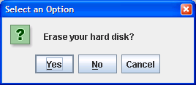
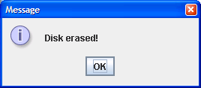
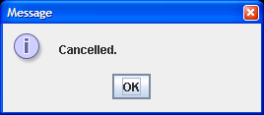
JOptionPane examples 2
showConfirmDialog analogous to a System.out.print that prints a question, then reading an input value from the user (can only be one of the provided choices)
import javax.swing.*;
public class ConfirmDialogExample {
public static void main(String[] args) {
int choice = JOptionPane.showConfirmDialog(null, "Erase your hard disk?");
if (choice == JOptionPane.YES_OPTION) {
JOptionPane.showMessageDialog(null, "Disk erased!");
} else {
JOptionPane.showMessageDialog(null, "Cancelled.");
}
}
}

Slide 8
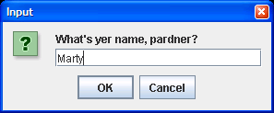
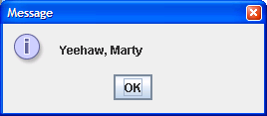
JOptionPane examples 3
showInputDialog analogous to a System.out.print that prints a question, then reading an input value from the user (can be any value)
import javax.swing.*;
public class InputDialogExample {
public static void main(String[] args) {
String name = JOptionPane.showInputDialog(null,
"What's yer name, pardner?");
JOptionPane.showMessageDialog(null, "Yeehaw, " + name);
}
}

Slide 9
Dialogs
Modal dialogs block all other interaction.
  Forces a response from the user.
Non-modal dialogs allow other interaction.
  This is sometimes desirable.
  May be difficult to avoid inconsistencies.
  JOptionPane is modal.

Slide 10

Onscreen GUI elements
Most GUIs are not composed of option panes; they are too limited. Instead, complex GUIs contain the following elements:
  frame: A graphical window on the screen.
  components: GUI widgets such as buttons or text fields.
  containers: Logical groups of components.

Slide 11
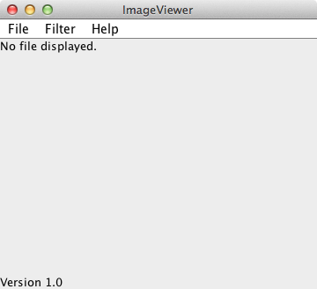
Elements of a frame
Window controls
Title
Menu bar
Content pane

Slide 12

JFrame example
A simple program that creates and shows a JFrame:
  import javax.swing.*;
  public class SimpleFrame {
  public static void main(String[] args) {
  JFrame frame = new JFrame();
  frame.setVisible(true);
  }
  }
Graphical output:

Slide 13
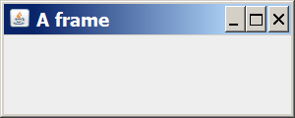
JFrame example
  import java.awt.*;
  import javax.swing.*;
  public class SimpleFrame2 {
  public static void main(String[] args) {
  JFrame frame = new JFrame();
  frame.setForeground(Color.WHITE);
  frame.setDefaultCloseOperation(JFrame.EXIT_ON_CLOSE);
  frame.setLocation(new Point(10, 50));
  frame.setSize(new Dimension(300, 120));
  frame.setTitle("A frame");
  frame.setVisible(true);
  }
  }
Graphical output:

Slide 14
JFrame properties
JFrames have the following properties that you can get/set:
name | type | description | methods
default close operation | int | what should happen when frame is closed | getDefaultCloseOperation, setDefaultCloseOperation
icon image | Image | icon in the window's title bar | getIconImage, setIconImage
layout | LayoutManager | how the frame should position its components | getLayout, setLayout
resizable | boolean | whether the window can be resized | isResizable, setResizable
title | String | window's title bar text | getTitle, setTitle

Slide 15
Component properties
name | type | description | methods
background | Color | background color | getBackground, setBackground
enabled | boolean | whether the component can be interacted with | isEnabled, setEnabled
font | Font | font used to display any text on the component | getFont, setFont
foreground | Color | foreground color | getForeground, setForeground
location | Point | (x, y) position of component on screen | getLocation, setLocation
size | Dimension | width, height of component | getSize, setSize
preferred size | Dimension | width, height that the component wants to be | getPreferredSize, setPreferredSize
visible | boolean | whether the component can be seen on screen | isVisible, setVisible

Slide 16
Creating a frame
import java.awt.*;
import java.awt.event.*;
import javax.swing.*;
public class ImageViewer
{
  private JFrame frame;
  /**
  * Create an ImageViewer show it on screen.
  */
  public ImageViewer()
  {
  makeFrame();
  }
  // rest of class omitted.
}

Slide 17

The content pane
/**
* Create the Swing frame and its content.
*/
private void makeFrame()
{
frame = new JFrame("ImageViewer");
Container contentPane = frame.getContentPane();
JLabel label = new JLabel("I am a label.");
contentPane.add(label);
frame.pack();
frame.setVisible(true);
}

Slide 18
Swing component hierarchy
Graphical components in Java form an inheritance hierarchy:
java.lang.Object
+--java.awt.Component
+--java.awt.Container
|
+--javax.swing.JComponent
| +--javax.swing.JButton
| +--javax.swing.JLabel
| +--javax.swing.JMenuBar
| +--javax.swing.JOptionPane
| +--javax.swing.JPanel
| +--javax.swing.JTextArea
| +--javax.swing.JTextField
|
+--java.awt.Window
+--java.awt.Frame
+--javax.swing.JFrame
When doing GUI programming, always import these packages:
import java.awt.*;
import javax.swing.*;

Slide 19
Adding menus
JMenuBar
  Displayed below the title.
  Contains the menus.
JMenu
  e.g. File. Contains the menu items.
JMenuItem
  e.g. Open. Individual items.

Slide 20
private void makeMenuBar(JFrame frame)
{
JMenuBar menubar = new JMenuBar();
frame.setJMenuBar(menubar);
// create the File menu
JMenu fileMenu = new JMenu("File");
menubar.add(fileMenu);
JMenuItem openItem = new JMenuItem("Open");
fileMenu.add(openItem);
JMenuItem quitItem = new JMenuItem("Quit");
fileMenu.add(quitItem);
}

Slide 21
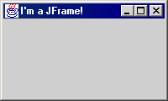
JFrame
A frame is a graphical window that can
be used to hold other components
public JFrame()
public JFrame(String title)
Creates a frame with an optional title.
public void setTitle(String text)
Puts the given text in the frame’s title bar.
public void setDefaultCloseOperation(int op)
Makes the frame perform the given action when it closes. Common value: JFrame.EXIT_ON_CLOSE
public void add(Component comp)
Places the given component or container inside the frame.
  How would we add more than one component to the frame?
NOTE: Call setVisible(true) to make a frame appear on screen after creating it.

Slide 22
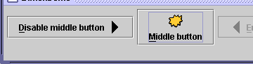
JButton, JLabel
The most common component—
a button is a clickable onscreen
region that the user interacts with
to perform a single command
A text label is simply a string of text
displayed on screen in a graphical
program. Labels often give infor-
mation or describe other components
public JButton(String text)
public JLabel(String text)
Creates a new button / label with the given string as its text.
public String getText()
Returns the text showing on the button / label.
public void setText(String text)
Sets button / label's text to be the given string.

Slide 23
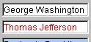

JTextField, JTextArea
A text field is like a label, except that the text
in it can be edited and modified by the user.
Text fields are commonly used for user input,
where the user types information in the field
and the program reads it
A text area is a multi-line text field
public JTextField(int columns)
public JTextArea(int lines, int columns)
Creates a new text field the given number of columns (letters) wide.
public String getText()
Returns the text currently in the field.
public void setText(String text)
Sets field's text to be the given string.

Slide 24
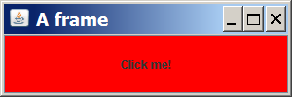
Components example
This program attempts to show 2 buttons:
  import java.awt.*;
  import javax.swing.*;
  public class ComponentsExample1 {
  public static void main(String[] args) {
  JFrame frame = new JFrame();
  frame.setDefaultCloseOperation(JFrame.EXIT_ON_CLOSE);
  frame.setSize(new Dimension(300, 100));
  frame.setTitle("A frame");
  JButton button1 = new JButton();
  button1.setText("I'm a button.");
  button1.setBackground(Color.BLUE);
  frame.add(button1);
  JButton button2 = new JButton();
  button2.setText("Click me!");
  button2.setBackground(Color.RED);
  frame.add(button2);
  frame.setVisible(true);
  }
  }

Slide 25
Layout problems
The preceding program added two buttons to the frame, but only one appeared on the screen.
layout manager: An object contained inside frames and other graphical containers that decides the position and size of the components inside the container.
The default layout manager sizes each component added to occupy the full window space.

Slide 26
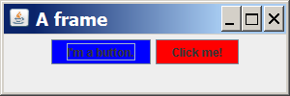
Changing layouts
We can correct the program's appearance by changing the frame's layout manager .
Change the layout by calling the setLayout method on the frame and passing a layout manager object.
  We will see several layout managers later.
  We'll use one called a FlowLayout, which sizes each component to its preferred size and positions them in left-to-right rows.
  If the following line is added to the preceding program just before calling setVisible(true), its appearance will be:
  frame.setLayout(new FlowLayout());

Slide 27
Event handling
Events correspond to user interactions with components.
Components are associated with different event types.
  Frames are associated with WindowEvent.
  Menus are associated with ActionEvent.
Objects can be notified when an event occurs.
  Such objects are called listeners.

Slide 28
Action events with
ActionListener
Event-driven programming
program's execution is indeterminate
on-screen components cause events to occur when they are
clicked / interacted with
events can be handled, causing the program to respond, driving the
execution thru events (i.e. an "event-driven" program)

Slide 29
Java Event Hierarchy
java.lang.Object
+--java.util.EventObject
+--java.awt.AWTEvent
+--java.awt.event.ActionEvent
+--java.awt.event.TextEvent
+--java.awt.event.ComponentEvent
+--java.awt.event.FocusEvent
+--java.awt.event.WindowEvent
+--java.awt.event.InputEvent
+--java.awt.event.KeyEvent
+--java.awt.event.MouseEvent
import java.awt.event.*;

Slide 30
Action events: ActionEvent
most common / simple event type in Swing
represent an action occurring on a GUI component
created by:
  button clicks
  check box checking / unchecking
  menu clicks
  pressing Enter in a text field
  etc.

Slide 31

Listening for events
attach a listener to the component
listener’s appropriate method will be called when event occurs (e.g. when the button is clicked)
for Action events, use ActionListener

Slide 32
Writing an ActionListener
// part of Java; you don't write this
public interface ActionListener {
public void actionPerformed(ActionEvent event);
}
// Prints a message when the button is clicked.
public class MyActionListener
implements ActionListener {
public void actionPerformed(ActionEvent event){
JOptionPane.showMessageDialog(null,
"An event occurred!");
}
}

Slide 33
Attaching an ActionListener
JButton button = new JButton("button 1");
ActionListener listener = new MyActionListener();
button.addActionListener(listener);
now button will print "Event occurred!" when clicked
  addActionListener method exists in many Swing components

Slide 34
Centralized event receipt
A single object handles all events.
  Implements the ActionListener interface.
  Defines an actionPerformed method.
It registers as a listener with each component.
  item.addActionListener(this)
It has to work out which component has dispatched the event.

Slide 35
ActionListener
public interface ActionListener
{
public void actionPerformed(ActionEvent ev);
}

Slide 36
public class ImageViewer implements ActionListener
{
…
public void actionPerformed(ActionEvent e)
{
String command = e.getActionCommand();
if(command.equals("Open")) {
…
}
else if (command.equals("Quit")) {
…
}
…
}
…
private void makeMenuBar(Jframe frame)
{
…
openItem.addActionListener(this);
…
}
}

Slide 37
Centralized event handling
The approach works.
It is used, so you should be aware of it.
However …
  It does not scale well.
  Identifying components by their text is fragile.
An alternative approach is preferred.

Slide 38
Nested class syntax
Class definitions may be nested.
  public class Enclosing
  {
  …
  private class Inner
  {
  …
  }
  }

Slide 39
Inner classes
Instances of the inner class are localized within the enclosing class.
Instances of the inner class have access to the private members of the enclosing class.

Slide 40
Anonymous inner classes
Obey the rules of inner classes.
Used to create one-off objects for which a class name is not required.
Use a special syntax.
The instance is always referenced via its supertype, as it has no subtype name.

Slide 41
Anonymous action listener
JMenuItem openItem = new JMenuItem("Open");
openItem.addActionListener(new ActionListener() {
public void actionPerformed(ActionEvent e) {
openFile();
}
});

Slide 42
Anonymous class elements
Anonymous object creation
openItem.addActionListener(
  new ActionListener()
  {
  public void actionPerformed(ActionEvent e)
  {
  openFile();
  }
  }
);
Class definition
Actual parameter

Slide 43
Exit on window close
frame.addWindowListener(new WindowAdapter() {
public void windowClosing(WindowEvent e)
{
System.exit(0);
}
});
WindowAdapter provides a no-op implementation of the WindowListener interface.

Slide 44
Problem: position, resize
How does the programmer specify where each component sits in the window, how big each component should be, and what the component should do if the window is resized/moved/maximized/etc?
Absolute positioning (C++, C#, others):
Specify exact pixel coordinates for every component
Layout managers (Java):
Have special objects that decide where to position each component based on some criteria
  What are benefits or drawbacks to each approach?

Slide 45
Layout managers
Manage limited space for competing components.
  FlowLayout, BorderLayout, GridLayout, BoxLayout, GridBagLayout.
Manage Container objects, e.g. a content pane.
Each imposes its own style.

Slide 46
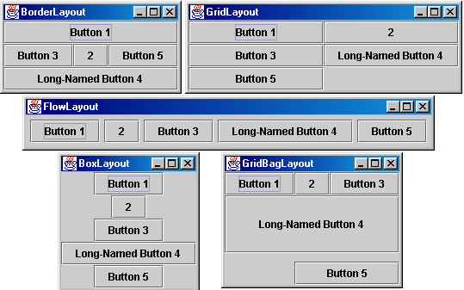
Layout managers
Here are several common Java layout managers:

Slide 47

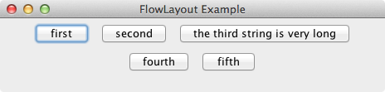
FlowLayout

Slide 48
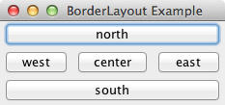
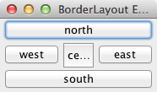
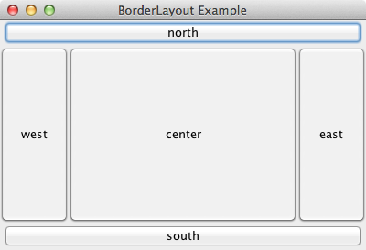
BorderLayout

Slide 49
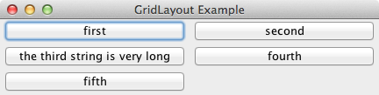
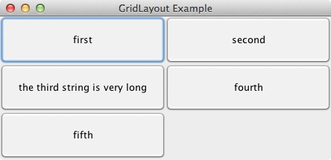
GridLayout

Slide 50
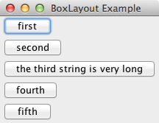
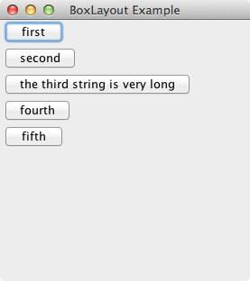
BoxLayout
Note: no component
resizing.

Slide 51
Containers
container: An object that holds components; it also governs their positions, sizes, and resizing behavior.
Containers have the following public methods:
  public void add(Component comp)
  public void add(Component comp, Object info)
  Adds a component to the container, possibly giving extra information about where to place it.
  public void remove(Component comp)
  Removes the given component from the container.
  public void setLayout(LayoutManager mgr)
  Uses the given layout manager to position the components in the container.
  public void validate()
  You should call this if you change the contents of a container that is already on the screen, to make it re-do its layout.

Slide 52
JPanel
A panel is our container of choice; it provides the methods from the previous slide and defines these additional methods (among others):
  public JPanel()
  Constructs a panel with a default flow layout.
  public JPanel(LayoutManager mgr)
  Constructs a panel that uses the given layout manager.

Slide 53

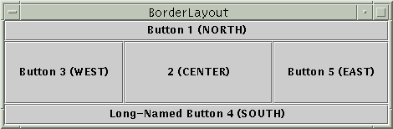
Preferred size
Swing component objects each have a certain size they would "like" to be--just large enough to fit their contents (text, icons, etc.)
This is called the preferred size of the component
Some types of layout managers (e.g. FlowLayout) choose to size the components inside them to the preferred size; others (e.g. BorderLayout, GridLayout) disregard the preferred size and use some other scheme
Buttons at preferred size: Not preferred size:

Slide 54
FlowLayout
public FlowLayout()
treats container as a left-to-right, top-to-bottom "page" or "paragraph"
components are given their preferred size both horizontally and vertically
components are positioned in order added
if too long, components wrap around to next line
Container panel = new JPanel(new FlowLayout());
panel.add(new JButton("Button 1"));

Slide 55
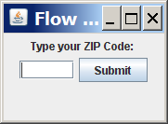

FlowLayout example
  import java.awt.*;
  import javax.swing.*;
  public class FlowLayoutExample {
  public static void main(String[] args) {
  JFrame frame = new JFrame();
  frame.setDefaultCloseOperation(JFrame.EXIT_ON_CLOSE);
  frame.setSize(new Dimension(320, 75));
  frame.setTitle("Flow layout");
  frame.setLayout(new FlowLayout());
  frame.add(new JLabel("Type your ZIP Code: "));
  frame.add(new JTextField(5));
  frame.add(new JButton("Submit"));
  frame.setVisible(true);
  }
  }

Slide 56
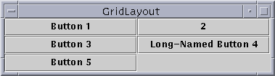
GridLayout
public GridLayout(int rows, int columns)
treats container as a grid of equally-sized rows and columns
components are given equal horizontal / vertical size, disregarding preferred size
can specify 0 rows or columns to indicate expansion in that direction as needed

Slide 57
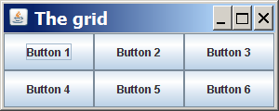
GridLayout example
  import java.awt.*;
  import javax.swing.*;
  public class GridLayoutExample {
  public static void main(String[] args) {
  JFrame frame = new JFrame();
  frame.setDefaultCloseOperation(JFrame.EXIT_ON_CLOSE);
  frame.setSize(new Dimension(300, 120));
  frame.setTitle("The grid");
  // 2 rows, 3 columns
  frame.setLayout(new GridLayout(2, 3));
  for (int i = 1; i <= 6; i++) {
  JButton button = new JButton();
  button.setText("Button " + i);
  frame.add(button);
  }
  frame.setVisible(true);
  }
  }

Slide 58
BorderLayout
public BorderLayout()
divides container into five regions: NORTH, SOUTH, WEST, EAST, CENTER
  NORTH and SOUTH regions expand to fill region horizontally, and use preferred size vertically
  WEST and EAST regions expand to fill region vertically, and use preferred size horizontally
  CENTER uses all space not occupied by others
Container panel = new JPanel(new BorderLayout());
panel.add(new JButton("Button 1 (NORTH)", BorderLayout.NORTH);

Slide 59
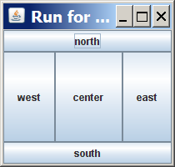
BorderLayout example
  import java.awt.*;
  import javax.swing.*;
  public class BorderLayoutExample {
  public static void main(String[] args) {
  JFrame frame = new JFrame();
  frame.setDefaultCloseOperation(JFrame.EXIT_ON_CLOSE);
  frame.setSize(new Dimension(210, 200));
  frame.setTitle("Run for the border");
  frame.setLayout(new BorderLayout());
  frame.add(new JButton("north"), BorderLayout.NORTH);
  frame.add(new JButton("south"), BorderLayout.SOUTH);
  frame.add(new JButton("west"), BorderLayout.WEST);
  frame.add(new JButton("east"), BorderLayout.EAST);
  frame.add(new JButton("center"),
  BorderLayout.CENTER);
  frame.setVisible(true);
  }
  }

Slide 60
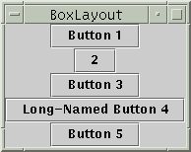
BoxLayout
Box.createHorizontalBox()
Box.createVerticalBox()
aligns components in container in a single row or column
components use preferred sizes and align based on their preferred alignment
preferred way to construct a container with box layout:
Box.createHorizontalBox(); or Box.createVerticalBox();

Slide 61

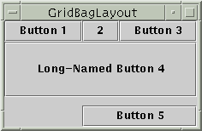
Other layouts
CardLayout
layers of "cards" stacked
on top of each other;
one visible at a time
GridBagLayout
very complicated;
recommendation: avoid

Slide 62
Nested containers
Sophisticated layouts can be obtained by nesting containers.
  Use JPanel as a basic container.
Each container will have its own layout manager.
Often preferable to using a GridBagLayout.

Slide 63
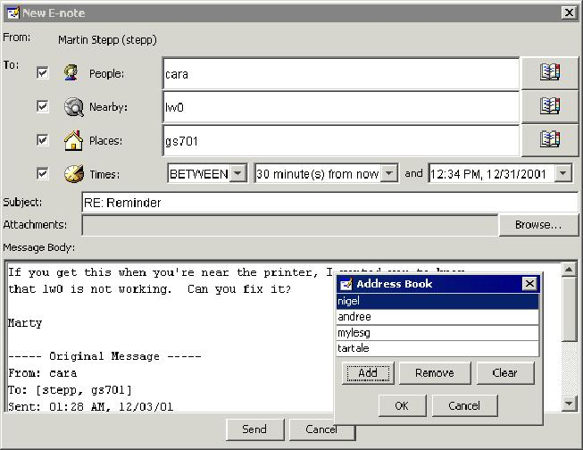
Complex layouts
How would you create a complex window like this, using the layout managers shown?

Slide 64
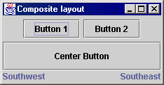
Solution: composite layout
create panels within panels
each panel has a different layout, and by combining the layouts, more complex / powerful layout can be achieved
example:
  how many panels?
  what layout in each?

Slide 65
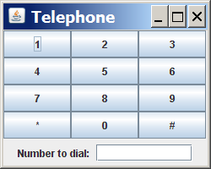
Composite layout example
  import java.awt.*;
  import javax.swing.*;
  public class Telephone {
  public static void main(String[] args) {
  JFrame frame = new JFrame();
  frame.setDefaultCloseOperation(JFrame.EXIT_ON_CLOSE);
  frame.setSize(new Dimension(250, 200));
  frame.setTitle("Telephone");
  frame.setLayout(new BorderLayout());
  JPanel centerPanel = new JPanel(new GridLayout(4, 3));
  for (int i = 1; i <= 9; i++) {
  centerPanel.add(new JButton("" + i));
  }
  centerPanel.add(new JButton("*"));
  centerPanel.add(new JButton("0"));
  centerPanel.add(new JButton("#"));
  frame.add(centerPanel, BorderLayout.CENTER);
  JPanel southPanel = new JPanel(new FlowLayout());
  southPanel.add(new JLabel("Number to dial: "));
  southPanel.add(new JTextField(10));
  frame.add(southPanel, BorderLayout.SOUTH);
  frame.setVisible(true);
  }
  }

Slide 66
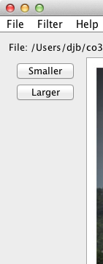
Buttons and nested layouts
A GridLayout inside
a FlowLayout inside
a BorderLayout.

Slide 67
Struts and Glue
Invisible components used as spacing.
Available from the Box class.
Strut: fixed size.
  Component createHorizontalStrut(int width)
  Component createVerticalStrut(int height)
Glue: fills available space.
  Component createHorizontalGlue()
  Component createVerticalGlue()

Slide 68
Borders
Used to add decoration around components.
Defined in javax.swing.border
  BevelBorder, CompoundBorder, EmptyBorder, EtchedBorder, TitledBorder.

Slide 69
Adding spacing
JPanel contentPane = (JPanel)frame.getContentPane();
contentPane.setBorder(new EmptyBorder(6, 6, 6, 6));
// Specify the layout manager with nice spacing
contentPane.setLayout(new BorderLayout(6, 6));
imagePanel = new ImagePanel();
imagePanel.setBorder(new EtchedBorder());
contentPane.add(imagePanel, BorderLayout.CENTER);

Slide 70
Other elements to consider, left for students to research:
JCheckBox, JRadioButton
ButtonGroup
ImageIcon
JScrollPane
JFileChooser
JColorChooser
JCheckBoxMenuItem, JRadioButtonMenuItem
Mnemonics
Accelerators
JComboBox
JTabbedPane
JToolBar
Jlist
Mouse and keyboard events
Slider
Spinner
Tabbed pane
Scroll pane

Slide 71
Tabbed pane see example in Layout managers.doc

